Slide 1
Canada Bankruptcy and Insolvency Data analysis
By: Raman Gill

Slide 2
Project goals:
To better understand the bankruptcy and insolvency in Canada from 1987 to 2023
How many proposals were filed
What is the trend for bankruptcies for various between businesses and consumers
What is the trend for insolvency between businesses and consumers

Slide 3
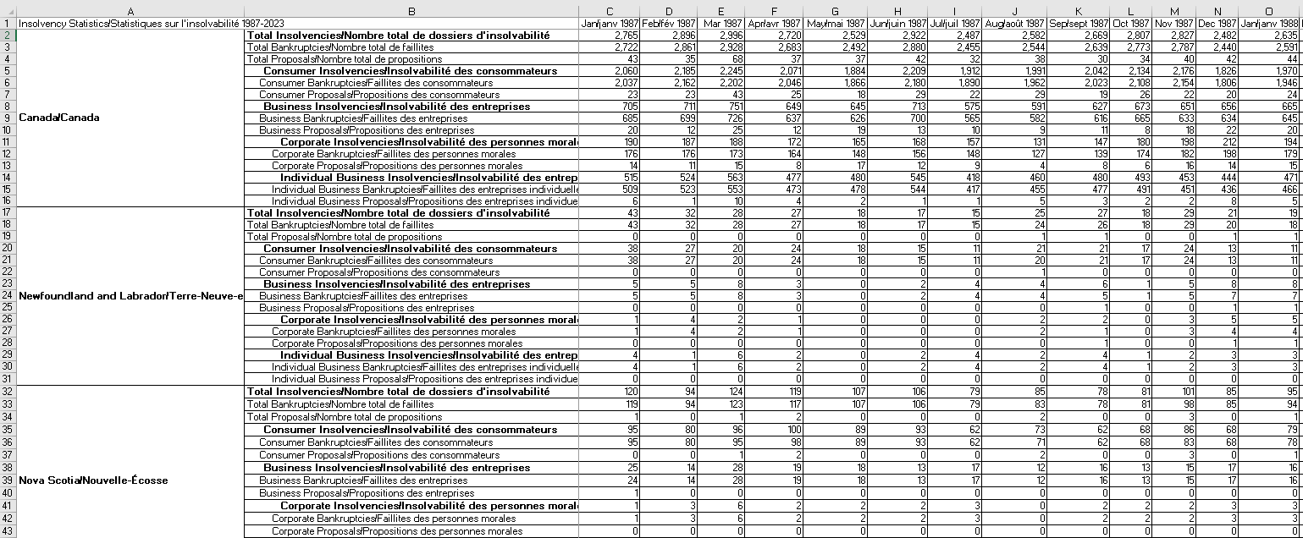
Data Source:
Government of Canada
https://open.canada.ca/data/en/dataset/746709f1-c729-44a1-ba84-7be5eadd3664

Slide 4
Data Review and Cleaning:
Performed In excel and Power Query
Updated date using flash fill
Transpose data
Delimiters for removal of French text
Appended data to add multiple sheets/tables into one table for analysis

Slide 5
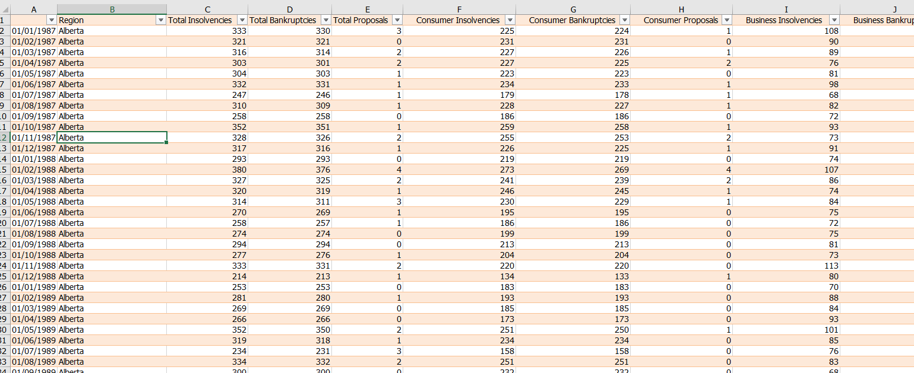
TRANSFORMED DATA:

Slide 6
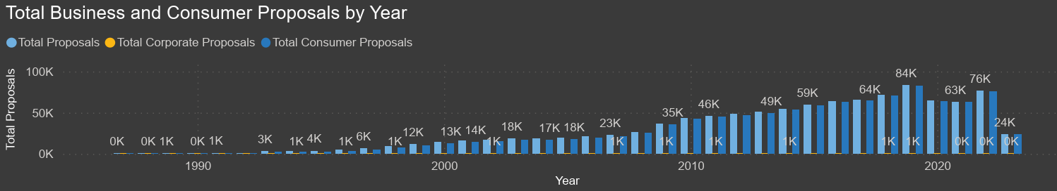
Total proposals:
Maximum number of proposals were filed in 2019 around 84,000 , with corporate proposals less than 1,000 and around 83,000

Slide 7
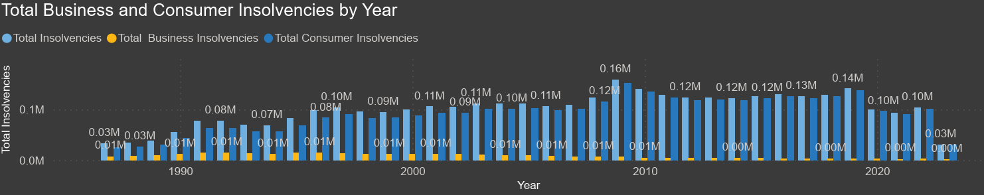
Total insolvencies:
Maximum number of insolvencies were in 2009 around 158,000 , with corporate insolvencies less than 7,000 and around 151,000

Slide 8
Total bankruptcies:
Maximum number of bankruptcies were in 2009 around 121,000 , with corporate bankruptcies less than 5,000 and around 116,000

